Slide 1
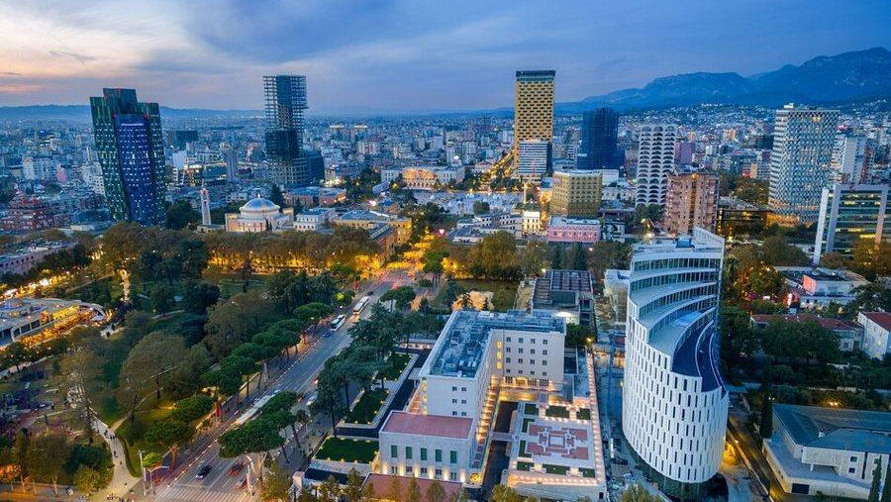
Albania Market Entry &
Commercial Growth Advisory
Local Insight. Commercial Execution. Sustainable Growth.
Helping international companies enter, navigate and grow in Albania.
COMPANY PROFILE
Notes:
Background image supplied by GB Growth Partners.

Slide 2
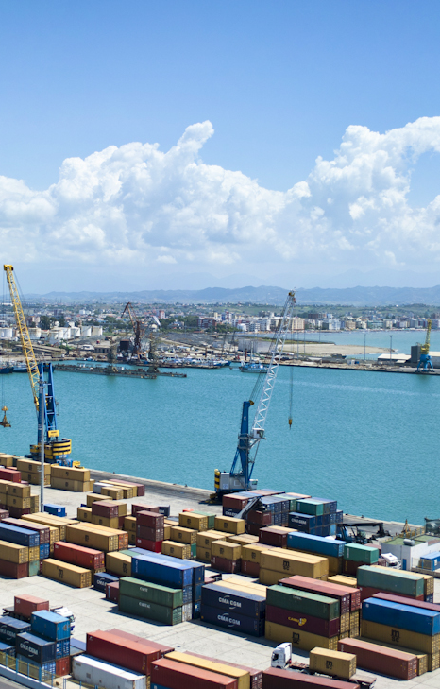
Why Albania?
A market of opportunity with room for growth
Strategic Location
Gateway between Western Balkans and EU markets.
Growing Economy
Increasing consumption and investment activity.
EU Integration Path
Continued alignment with European standards.
Competitive Cost Base
Efficient operating costs compared with many European markets.
GB GROWTH PARTNERS
02
Notes:
Photo: “Panorama of Durres Port” by Matthias Krüttgen, Wikimedia Commons, CC0 1.0. Source: https://commons.wikimedia.org/wiki/File:Panorama_of_Durres_Port.jpg
Context sources: World Bank Albania overview and European Commission Albania accession page. Market attractiveness and cost claims require category-specific validation.

Slide 3
The Challenge
Entering Albania successfully requires more than market data
01
Limited Market Visibility
02
Partner Selection Risk
Reliable information is often difficult to access.
Choosing the wrong distributor can delay growth.
03
Regulatory Complexity
04
Execution Risk
Local procedures require knowledge and coordination.
Many market entries lose momentum during implementation.
GB Growth Partners reduces uncertainty and accelerates commercial decision-making.
GB GROWTH PARTNERS
03

Slide 4
What We Do
01
Market Intelligence
Market size, competition, pricing and route-to-market assessment.
02
Partner Search & Assessment
Identification and evaluation of distributors and commercial partners.
03
Market Entry Strategy
Go-to-market design, launch planning and commercial priorities.
04
Commercial Representation
Ongoing local support, partner management and business development.
GB GROWTH PARTNERS
04

Slide 5

Why GB Growth Partners
Local Network
Commercial Experience
Relationships across distributors, retailers and key stakeholders.
Over 20 years of commercial leadership in Albania.
Independent Advice
Execution Focus
Recommendations grounded in market reality.
Support that continues beyond strategy.
We do not simply advise. We help clients execute.
GB GROWTH PARTNERS
05
Notes:
Background image supplied by GB Growth Partners.

Slide 6
Our Market Entry Framework
A disciplined path from the first question to market execution
01
02
03
04
UNDERSTAND
›
VALIDATE
›
BUILD
›
EXECUTE
Objectives, economics and success criteria.
Demand, competition and channel dynamics.
Market entry plan and partner strategy.
Commercial implementation and local support.
GB GROWTH PARTNERS
06

Slide 7
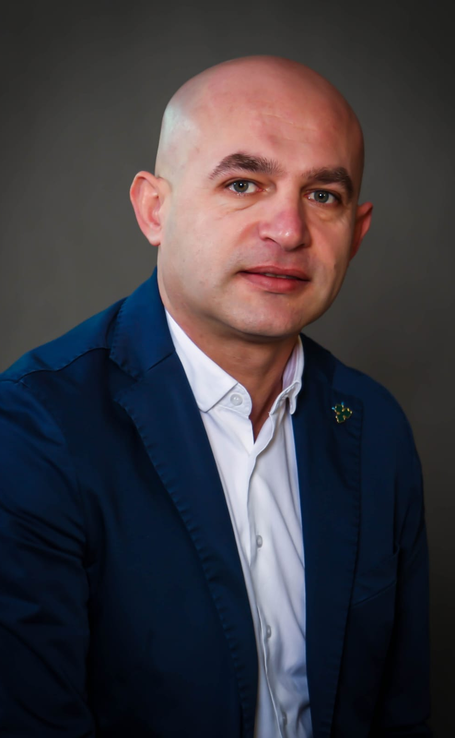
FOUNDER & MANAGING CONSULTANT
Genti Biturku
Founder & Managing Consultant
20+ Years Commercial Leadership
INDUSTRY EXPERIENCE
CORE EXPERTISE
FMCG
Telecommunications
Construction Materials
Market Entry
Business Development
Distributor Development
Route-to-Market
Commercial Strategy
Combining strategic thinking with practical commercial execution in Albania.
GB GROWTH PARTNERS
07

Slide 8
Extended Local Capabilities
One point of accountability with access to specialist expertise when required.
Legal Support
Commercial Experts
Regulatory Advisors
Market Research
Recruitment Partners
Industry Specialists
GB GROWTH PARTNERS
08

Slide 9
Example Engagement
CHALLENGE
APPROACH
OUTCOME
International company evaluating commercial opportunities in Albania.
Market assessment
Channel review
Competitor analysis
Distributor evaluation
Clear market entry recommendation
Qualified partner shortlist
Launch roadmap
Reduced commercial risk
A focused engagement turns an open market question into a practical entry decision.
GB GROWTH PARTNERS
09

Slide 10
Ready To Explore Albania?
Local Insight. Commercial Execution. Sustainable Growth.
Genti Biturku
Founder & Managing Consultant
gentibiturku@gmail.com
+355 69 204 0075
LinkedIn: Genti Biturku
Notes:
Background photo: “Panorama of Durres Port” by Matthias Krüttgen, Wikimedia Commons, CC0 1.0. Source: https://commons.wikimedia.org/wiki/File:Panorama_of_Durres_Port.jpg

